Slide 1

Introducing WPF
Paul Stovell
Senior Developer, Readify
Notes:
Introduction slide: this slide must be the first slide in every RDN deck. Update the following:
Title of Talk
Presenter Name
Presenter Position

Slide 2
Why WPF?

Slide 3
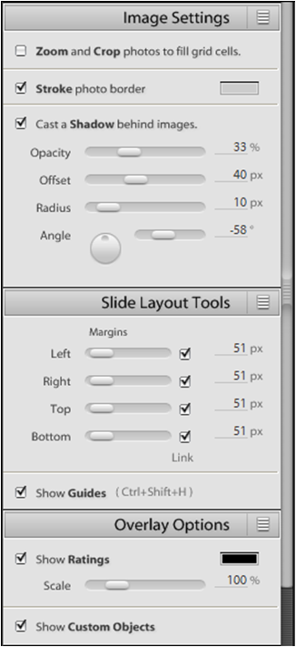

Slide 4
WPF Features

Slide 5
Agenda
A quick introduction to WPF
Corporate branding and consistency with Styles and Resources
Emphasizing information with Animation
Code reduction through Data Binding
Task-focussed user interfaces with Navigation
Summary

Slide 6
Introducing WPF
WPF uses DirectX
Everything is a vector
Everything lives in a tree
XAML is a convenient way to represent the tree
Anything goes in anything

Slide 7
Introducing WPF
Styles and Resources
Styles – CSS for WPF
Triggers – apply CSS based on events or conditions
Control Templates – completely customize control rendering
Resources – anything you use twice
Best practices:
Use these features as much as possible
Separate “functional” XAML from “visual” XAML
Apply a consistent naming scheme for resources
Organise resources appropriately
Use DynamicResource sparingly

Slide 8
Introducing WPF
Animation
Changing a property value over time
Animations are time boxed
Multiple animations live in a storyboard
Storyboards are resources too
Best practices:
Animations should be fast and subtle
Don’t distract the user’s eyes
Storyboards are resources too
Animations on invisible elements still consume CPU cycles

Slide 9
Introducing WPF
Data Binding
Binding to data objects
Binding to collections of data objects
Binding to elements
Converters
Multi bindings
Best practices:
Take time to understand binding
Implement INotifyPropertyChanged on all objects
Bind each control to itself, and expose data via properties instead
Prefer DataContext to ObjectDataSource
Check out Bindable LINQ: www.codeplex.com/bindablelinq

Slide 10
Introducing WPF
Navigation
Pages are like Web Pages
Pages live in Frames (or in XBAP’s)
NavigationService enables navigation
PageFunctions can be strung together to create tasks
Best practices:
Use KeepAlive=true on PageFunctions
Take time to understand the page lifecycles
Focus on goals rather than tasks
Don’t make assumptions about the container
Use a common style for all pages

Slide 11
SP1 and 4.0

Slide 12
Where is WPF going?
Deployment
Client Redistributable - ~30mb
Brandable ClickOnce Deployment
Deployment Bootstrapper

Slide 13
Where is WPF going?
Performance
Container Recycling
Scrolling
Virtualized TreeView
First load of CLR – 15-40% faster
Minor WPF improvements
Smoother Animations
Hardware Bitmap Effects

Slide 14
Where is WPF going?
LOB Controls
Data Grid
Ribbon
Calendar, Date, Time
Masked edit, spinner
Auto completion and picklist
Breadcrumbs
Property Grid

Slide 15
Where is WPF going?
Synergy with Silverlight
Short-term conceptual compatibility
Long-term source-level compatibility
WPF as a first-class Silverlight host
Interaction between Silverlight and WPF applications

Slide 16
Where is WPF going?
Enterprise and Extensibility
Composite WPF Application Guidance
System.AddIn support

Slide 17
Where is WPF going?
Compelling UX additions
Page inheritence ala Master Pages
Transitions, layout to layout animation
Theme packs for control skins
Single Instance Application, Tray Icon/Taskbar

Slide 18
A Readify Developer Network session
By Paul Stovell, Senior Developer, Readify
Email Address: paul.stovell@readify.net
RDN Website: www.readify.net/rdn
Notes:
Conclusion slide – this slide must be included in every presentation deck and should be the last slide. Update the following:
Presenter Name
Presenter Position
presenter.name@readify.net

